Slide 1
Counter Culture,
Tin Foil Hats,
and the CyberPunk Age
Notes:
Hello everyone and thank you for coming. My name is Josh and this is Counter Culture, Tin Foil Hats, and the CyberPunk Age.

Slide 2
“I hold it, that a little
rebellion, now and then,
is a good thing, and as
necessary in the political
world as storms in the
physical.”
-Thomas Jefferson
Notes:
Activism is the single most important tool we have as a people to foster change on a grand scale. Activism can take many forms from writing letters, to boycotts, to marches and protests. The path to American Revolution was first set by early American activists. People like John Hancock and Samuel Adams participated in actions directed against the British first as members of the Boston Caucus Club then later as members of the Sons of Liberty.

Slide 3
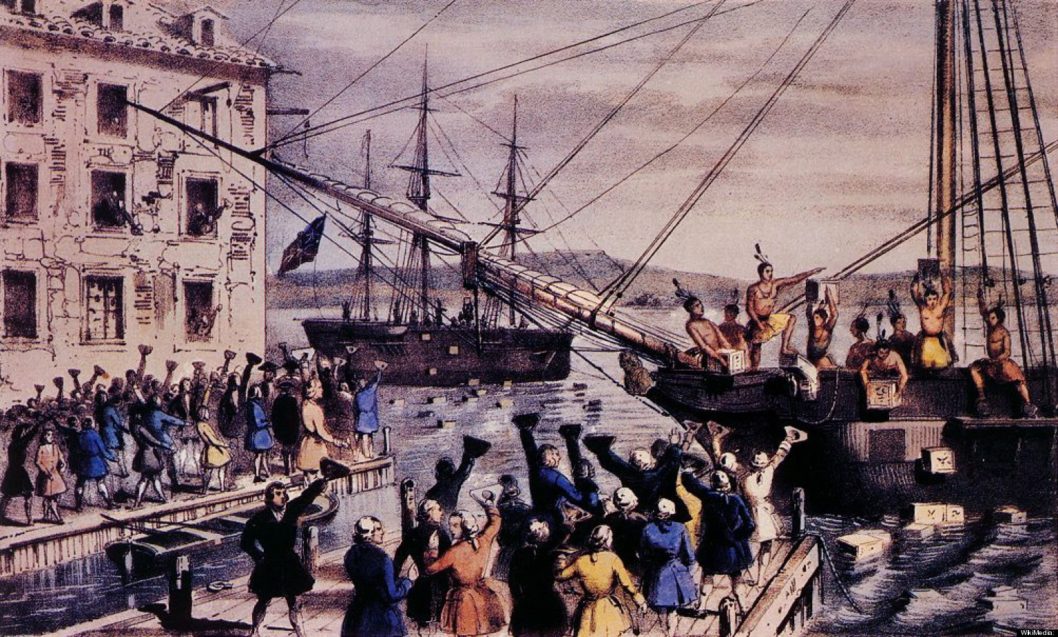
Notes:
The Sons of Liberty were involved in some of the most iconic actions in History like the burning of the HMS Gaspeeand the Boston Tea Party. The Sons of Liberty were also instrumental in spreading propaganda that made the Boston Massacre seem worse than it actually was. Many of the Sons members were printers and were instrumental in distributing articles that swayed public opinion against the British.
-
But technology has evolved. And surveilance has evolved with it. Activism is becoming more difficult.

Slide 4
“The future is already
here — it's just not
very evenly distributed.”
-William Gibson
Notes:
The writings of CyberPunk authors such as William Gibson and Bruce Sterling, paint a bleak picture of some dystopian near-future where technology permeates nearly all aspects of our lives, the divide between the have and the have-nots has never been greater, and corporations rule the Earth.
-
I believe that future has already come to pass. Slowly and quietly we have been overtaken by the promises of the genre. It just doesn't look like we thought it would.

Slide 5
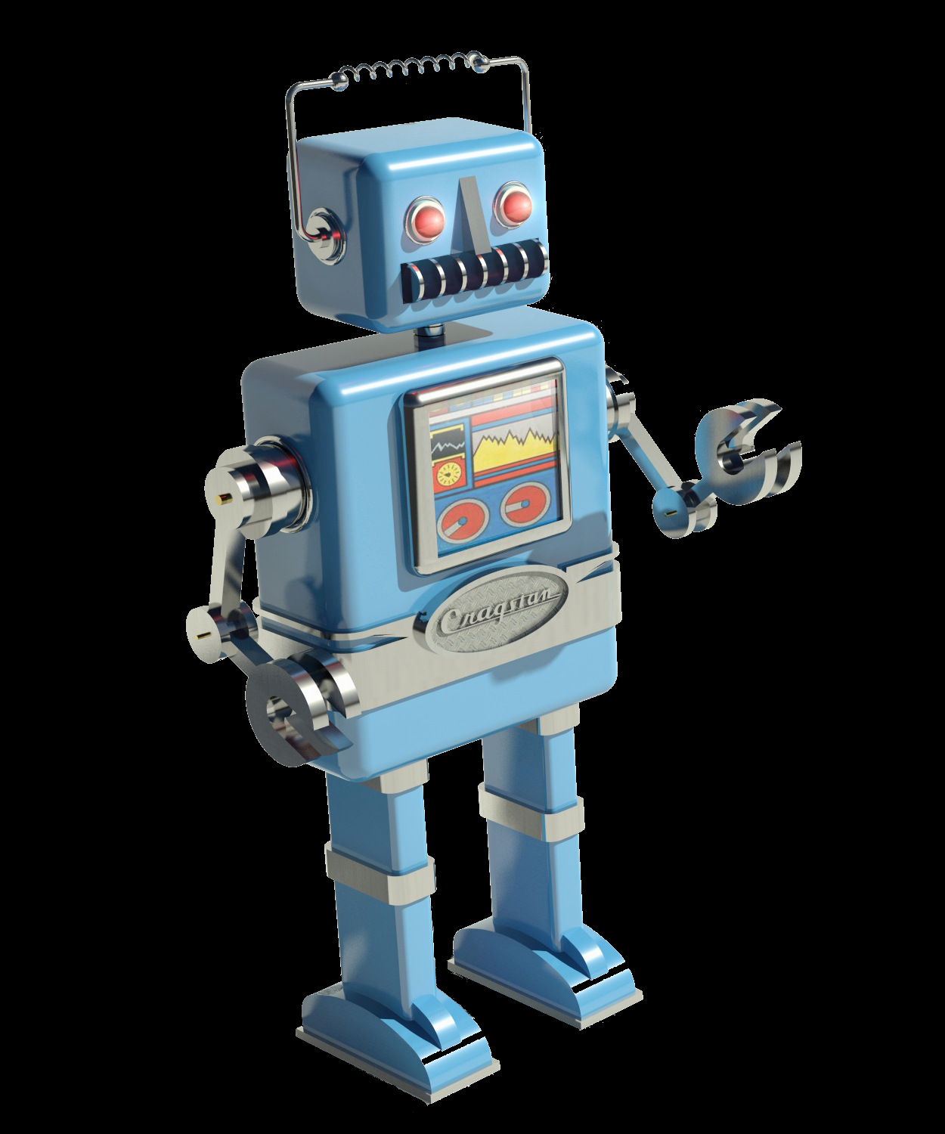
Notes:
The first promise of CyberPunk is pervasive technology.
-
We have powerful computers we carry in our pockets and call cell phones. They are full of sensors and radios, they have more processing power, ram and storage than desktop computers I owned as much as 5 years ago.
There are cyborgs walking among us. Senses have been restored using technology such as Cochlear implants and Dobelle Brain implants. Limbs have been restored with prosthetic appendages that can actually improve certain functions.

Slide 6
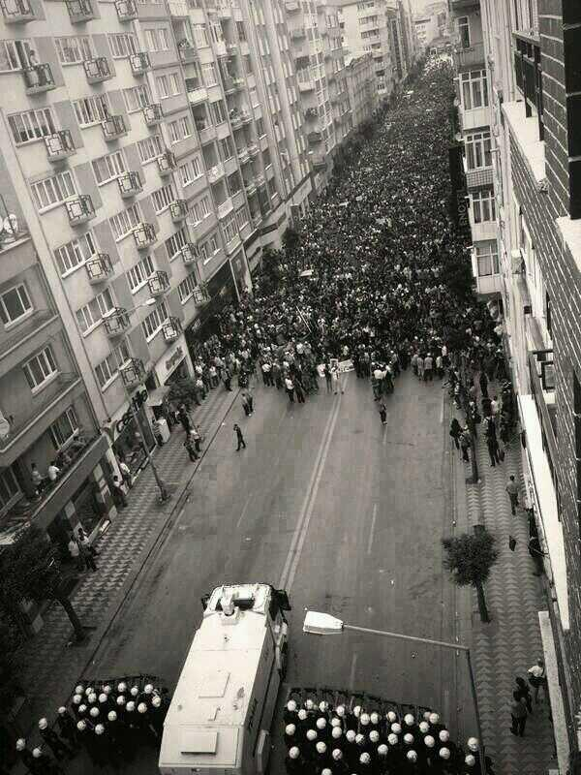
Notes:
The Second Promise is economic disparity. Movements like Occupy Wall St. Phrases like the 1% and a worldwide rescession over the last several years have highlighted this.
The Third Promise is Corporate Governance. And we have that. Politicians are widely considered to be in the pockets of powerful corporate interests. Companies like Monsanto have armies of private investigators that they send into the field to monitor farmers crops for signs that they are using Monsanto Pantented Seed. Sue anyone who violates that
-
HSBC officials got a slap on the wrist for money laundering for drug cartels and terrorist orgs. They paid an equivalent of a month of profit. Just as a comparison based off of averages of income and cost of living the average American equivalent would be in the $2000 range.

Slide 7
"F*** tha Police"
-N.W.A.
Notes:
COINTELPRO
- FBI Program ran between 1956 1971
- Illegal, unethical, targeted members of the civil rights movement, Environmental/Animal Rights Activists.
- Many elements still exist today. Pacifist activists are placed on terrorist watch lists. Did not inform Occupy Wall St. Members of asssassination plots

Slide 8
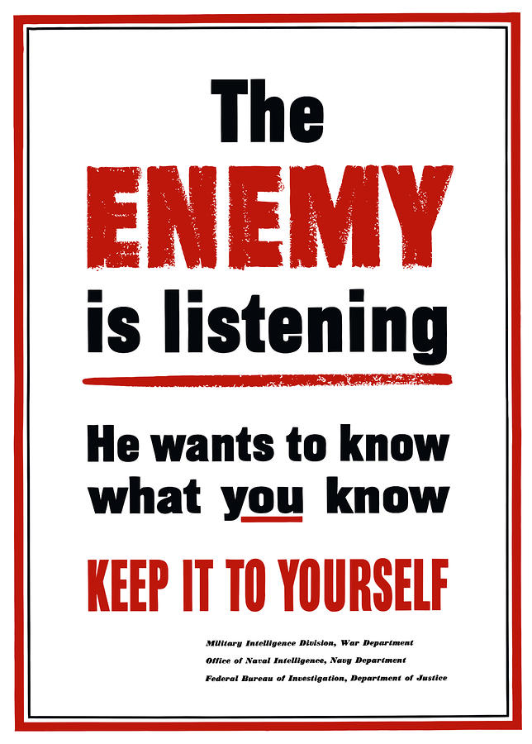
Notes:
With the advances in technology and the rise of Corporations, surveillance becomes cheap, ubiquitous, and necessary to sustain their business models. The governments surveil their citizens to protect their interests, which is ultimately prosperity and the welfare of its corporations. Corporations surveil people to promote their agenda.
The NSA is spying on everyone. LEO is watching you from an ever increasing array of city surveilance.Your grocery store is tracking you through your purchases with the store loyalty card. WiFi hotspots in Department Stores track your movements and mine data from your mobile devices.

Slide 9
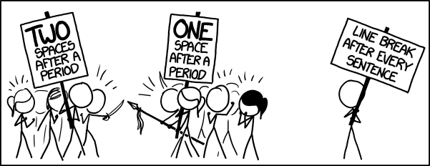
obligatory XKCD*
Notes:
Deciding what kind of activism to participate in is the first step.
Participation in activism can take many forms and consequences can last a lifetime.
Joshua Inglett lost his position on Wisconson Governer Scott Walker's Board of Regents because of a petition he singed on his mother's request.
God forbid you get linked to Greenpeace.
The type of activism you participate in will determine the safeguards you need to take.

Slide 10
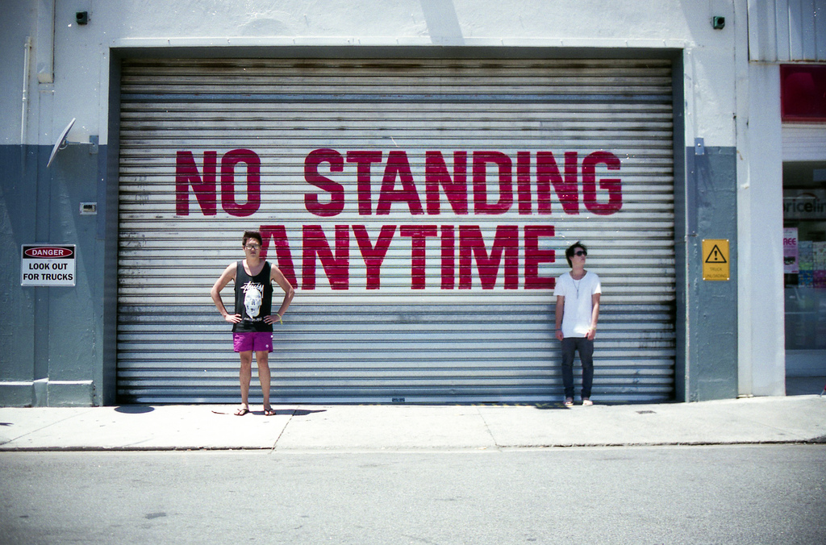
Notes:
Lets break one law at a time.

Slide 11
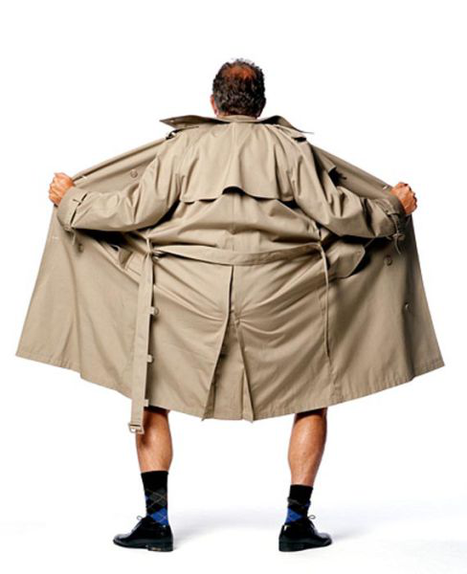
Notes:
Full blown public is an approach.
For the most part this is the path I take. I protect some things but my participation in Activism as well as the acts I perform are generally very public and broadcast on my twitter feed.

Slide 12

Notes:
Cover Identity
- Create a background
- Dedicated Equipment
- Social Media
- Do not log in in the same places you would log into real world stuff

Slide 13
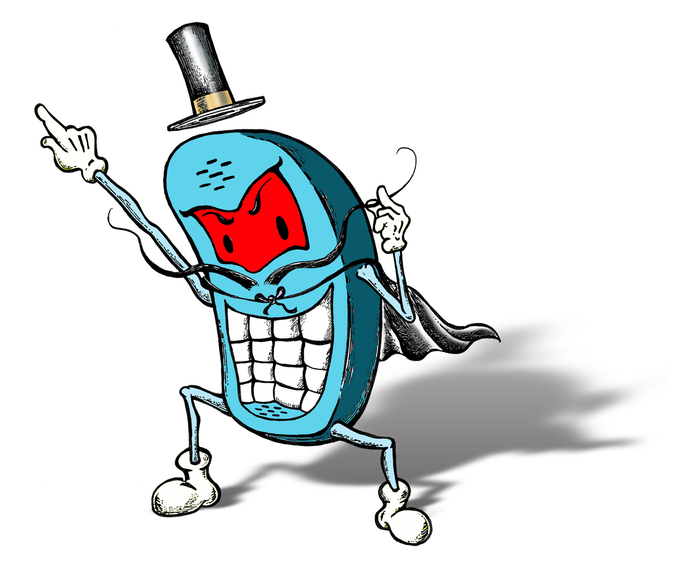
Notes:
Your cell phone is an evil surveillance device.
Cell Phones cannot be trusted.
Gus Hunt CIA, 3-Axis Accelerometer

Slide 14

Notes:
Disgusing yourself can help. Mask your face, Guy Fawkes, BlackBloc techniques

Slide 15




Slide 16
@scottjosh
josh@wtftacos.com
wtftacos.com
Notes:
asdf

